Slide 1
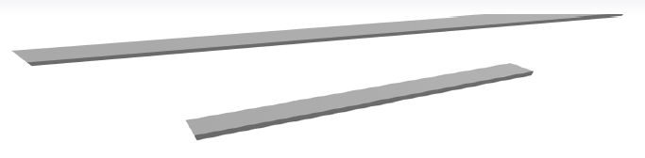
KVX Wear Bar
An excellent Sagitta steel wear protection solution for a wide range of applications including:
Bucket liners (internal & external, in both impact and wear zones)
Dozer blade liners (some applications)
Hopper liners (crushers, feeders, etc)
Dump truck liners (long wearing & easy to replace quickly where worn)
Features/benefits:
~500HB throughout
High KVX toughness
No stripping defects
No stripping losses
No stripping labour
Attractive economics!
Typical customer comment:
“As easy to weld as 400HB, and wears longer than competitive 500HB!”

Slide 2
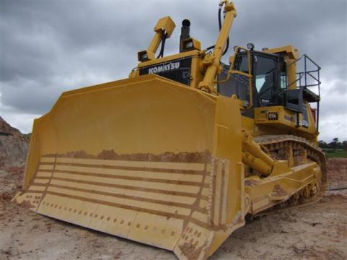
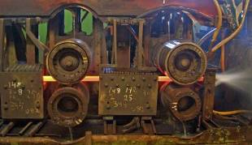
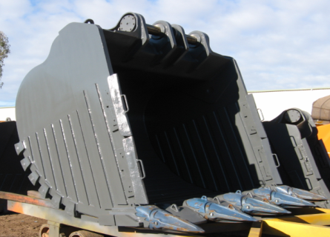
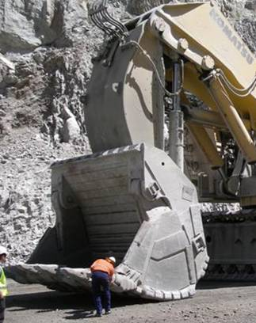
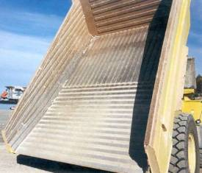
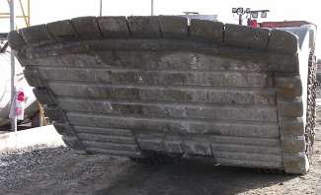
KVX Wear Bar

Slide 3
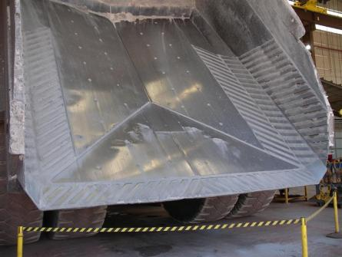
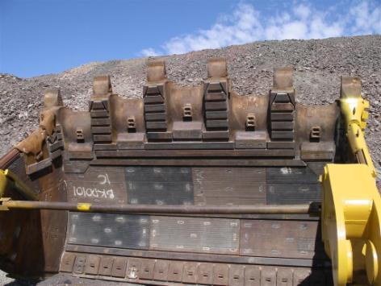
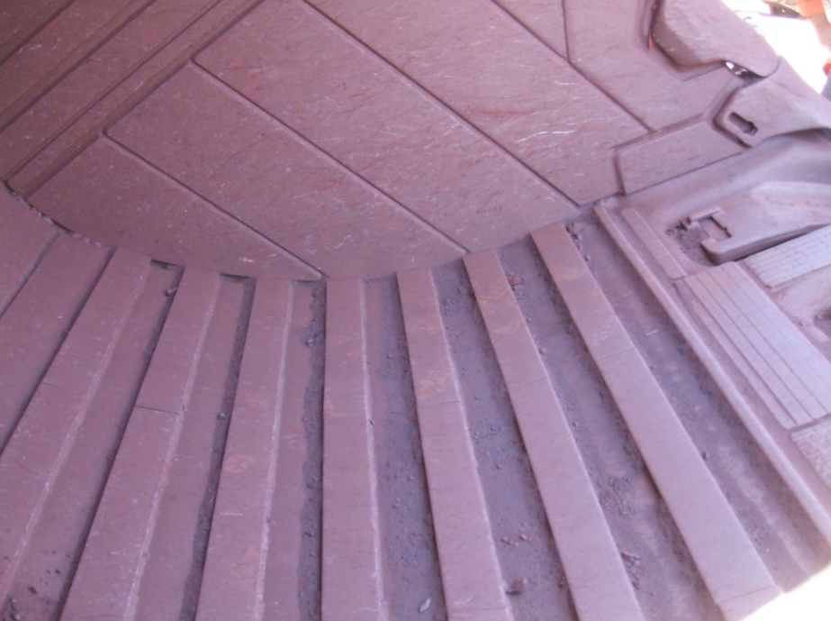
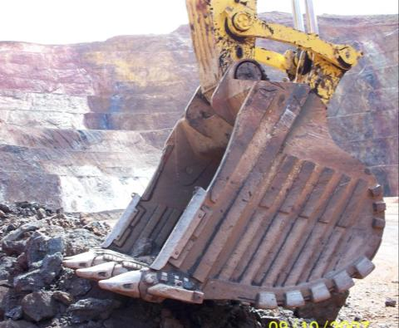
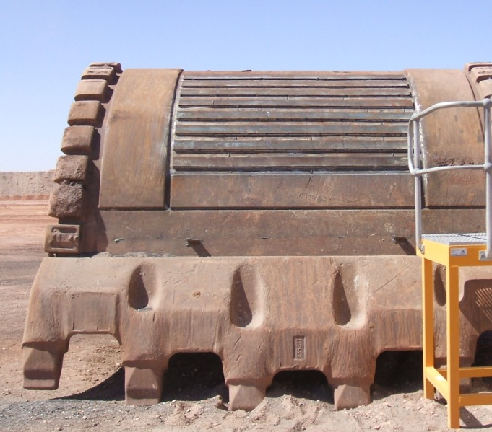
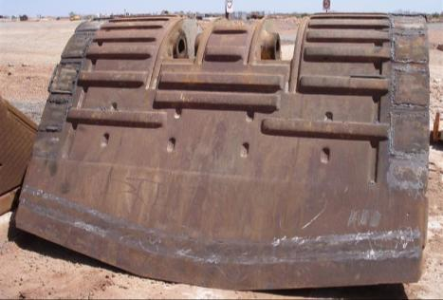
KVX Wear Bar

Slide 4
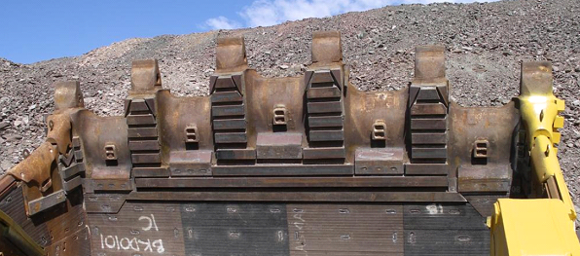
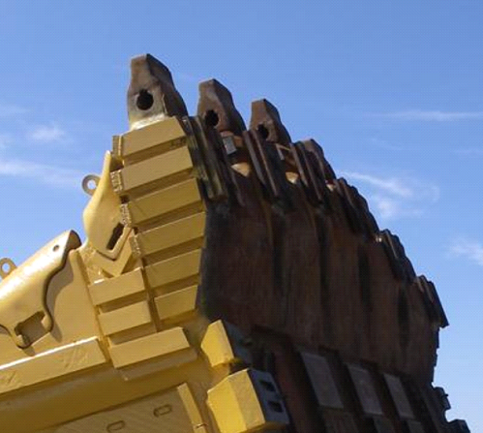
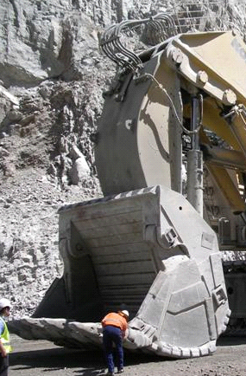
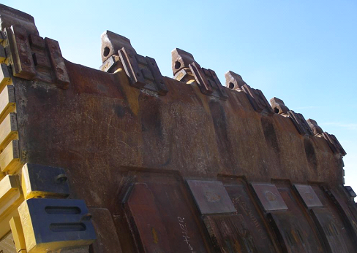
KVX Wear Bar
Application: 800t FS x 3 (Gold Mine, Australia)
Replace troublesome mechanical wear caps
Protect cast lip internally
Protect cast lip externally
Protect impact zones on main bucket shell
Wear liners, underside of clam

Slide 5
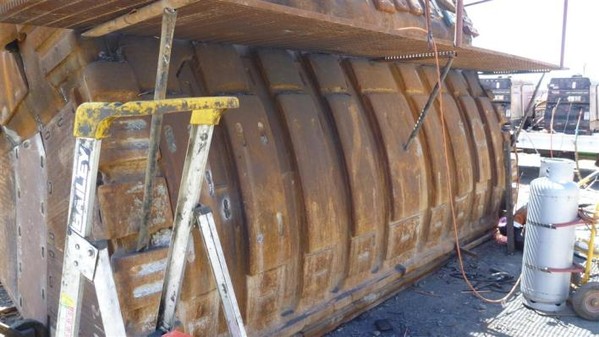
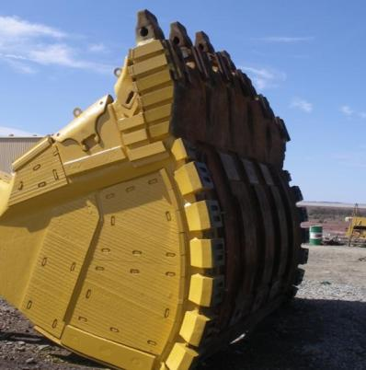
KVX Wear Bar
Application: 800t FS x 3 (Gold Mine, Australia)
Customer is utilising KVX rolled “banana bars” externally on the clam (high wear and impact)
These custom rolled parts (50~60mm thick) were previously made from Hardox 450 (450 HB)
Previous results with Hardox 450: max 4,000hrs (typically 3500hrs)
KVX versions with same dimensions lasting 10~12,000hrs!

